Slide 1
Generalised Verification for Quantified Permissions
Final Presentation of Master Thesis Project
Nadja Müller
29 September 2016
Supervisor: Alex Summers

Slide 2
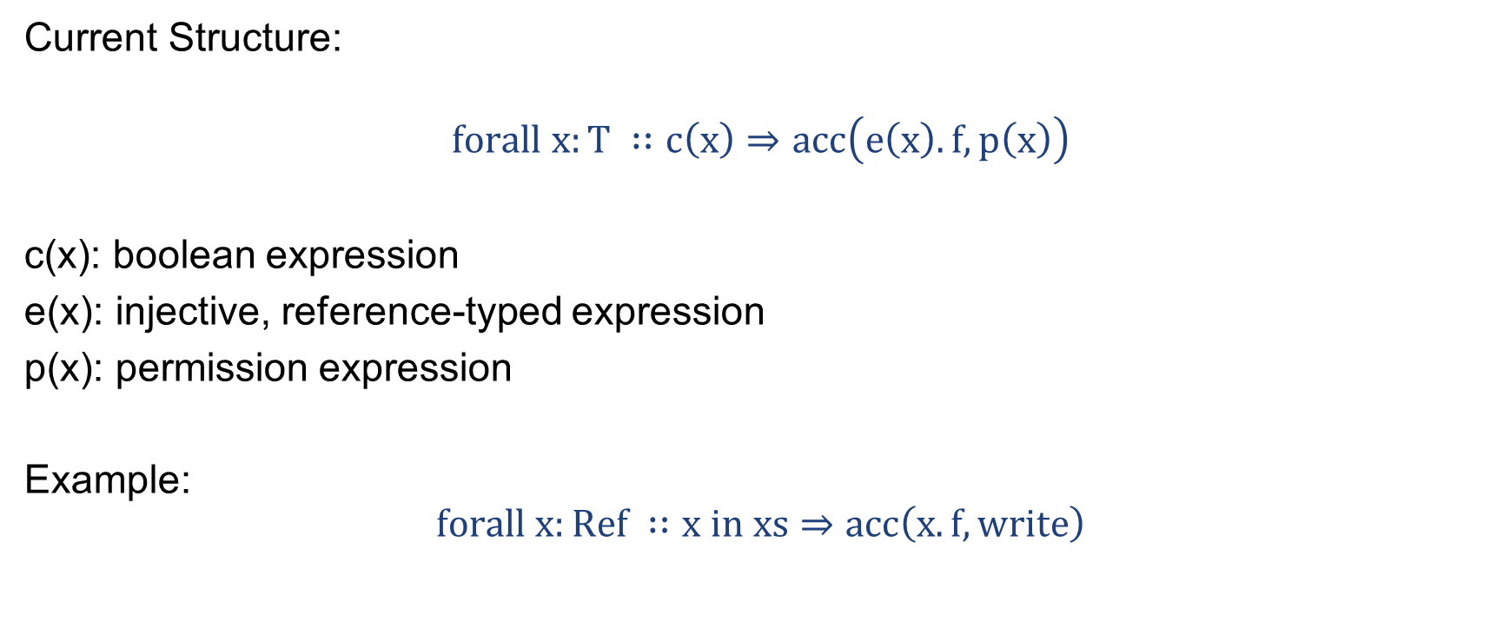
Quantified Permissions
Current Structure:
$$forall x:T ∷c\left(x\right)⇒acc\left(e\left(x\right).f, p\left(x\right)\right)$$
c(x): boolean expression
e(x): injective, reference-typed expression
p(x): permission expression
Example:
$$forall x:Ref ∷x in xs⇒acc\left(x.f, write\right)$$

Slide 3
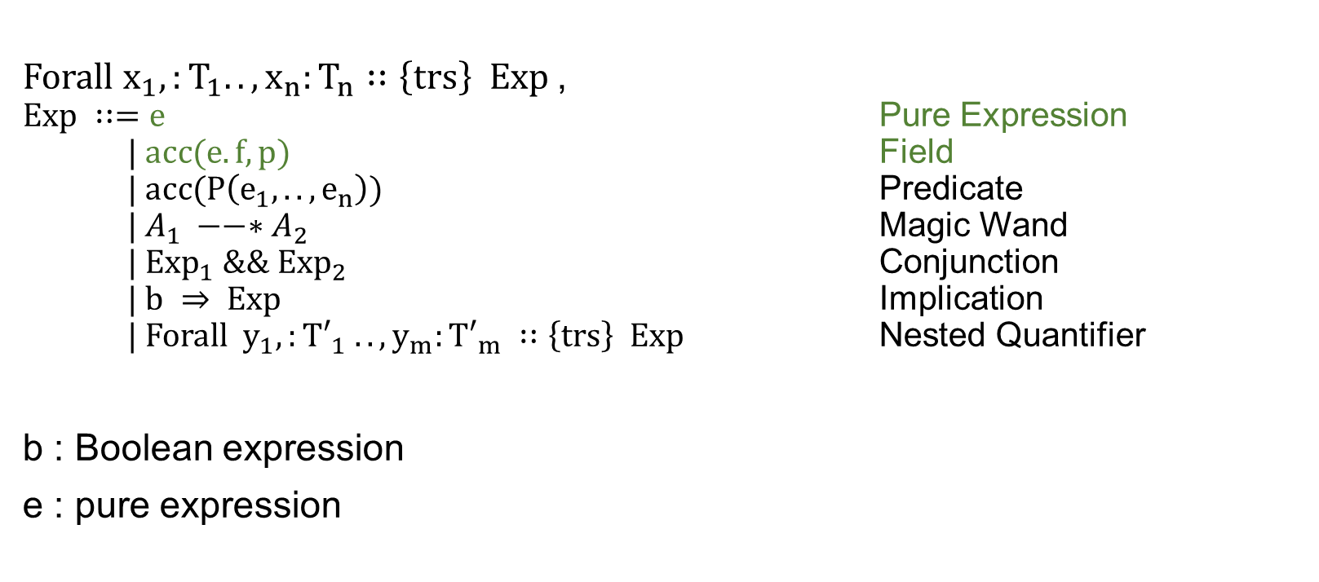
Generalisation
$Forall x_{1},:T_{1}..,x_{n}:T_{n}∷\left\{trs\right\} Exp$,
$Exp ∷=e$ Pure Expression $| acc(e.f, p)$ Field
$| acc(P\left(e_{1}, ..,e_{n}\right))$ Predicate
$| A_{1} −−∗A_{2}$ Magic Wand
$| {Exp}_{1} \&\&{ Exp}_{2}$ Conjunction
$| b ⇒ Exp$ Implication $\text{| }Forall y_{1},:{T′}_{1} ..,y_{m}:{T′}_{m} ∷\left\{trs\right\} Exp$ Nested Quantifier
b : Boolean expression
e : pure expression

Slide 4
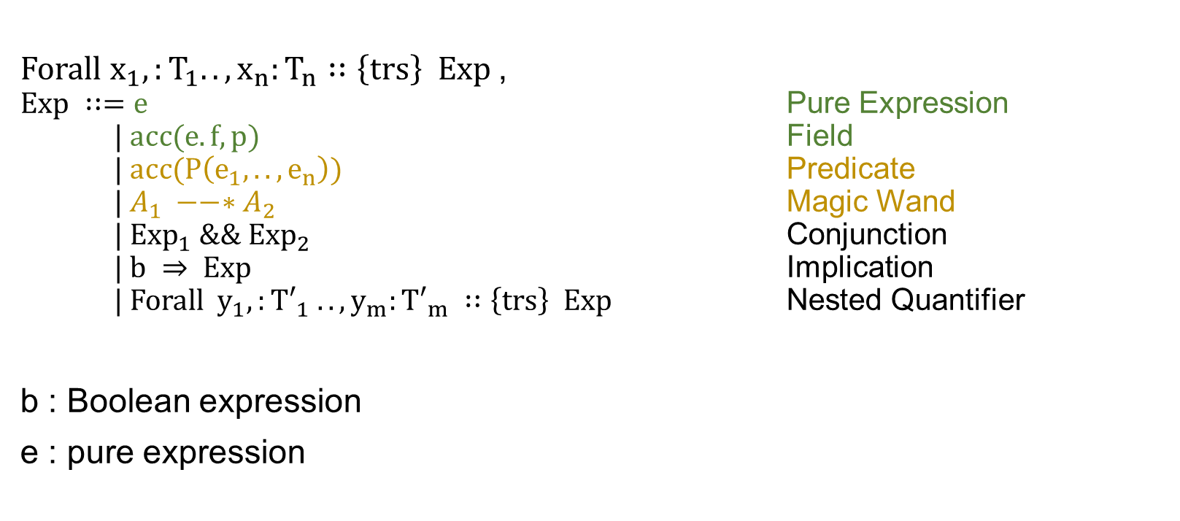
Generalisation
$Forall x_{1},:T_{1}..,x_{n}:T_{n}∷\left\{trs\right\} Exp$,
$Exp ∷=e$ Pure Expression $| acc(e.f, p)$ Field
$| acc(P\left(e_{1}, ..,e_{n}\right))$ Predicate
$| A_{1} −−∗A_{2}$ Magic Wand
$| {Exp}_{1} \&\&{ Exp}_{2}$ Conjunction
$| b ⇒ Exp$ Implication $\text{| }Forall y_{1},:{T′}_{1} ..,y_{m}:{T′}_{m} ∷\left\{trs\right\} Exp$ Nested Quantifier
b : Boolean expression
e : pure expression

Slide 5
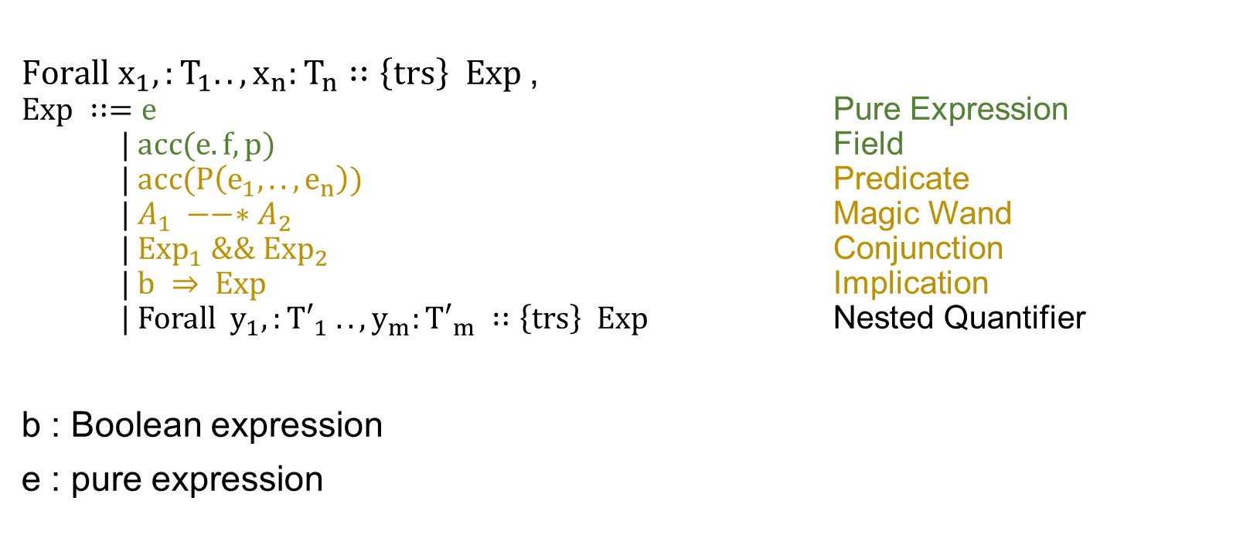
Generalisation
$Forall x_{1},:T_{1}..,x_{n}:T_{n}∷\left\{trs\right\} Exp$,
$Exp ∷=e$ Pure Expression $| acc(e.f, p)$ Field
$| acc(P\left(e_{1}, ..,e_{n}\right))$ Predicate
$| A_{1} −−∗A_{2}$ Magic Wand
$| {Exp}_{1} \&\&{ Exp}_{2}$ Conjunction
$| b ⇒ Exp$ Implication $\text{| }Forall y_{1},:{T′}_{1} ..,y_{m}:{T′}_{m} ∷\left\{trs\right\} Exp$ Nested Quantifier
b : Boolean expression
e : pure expression

Slide 6
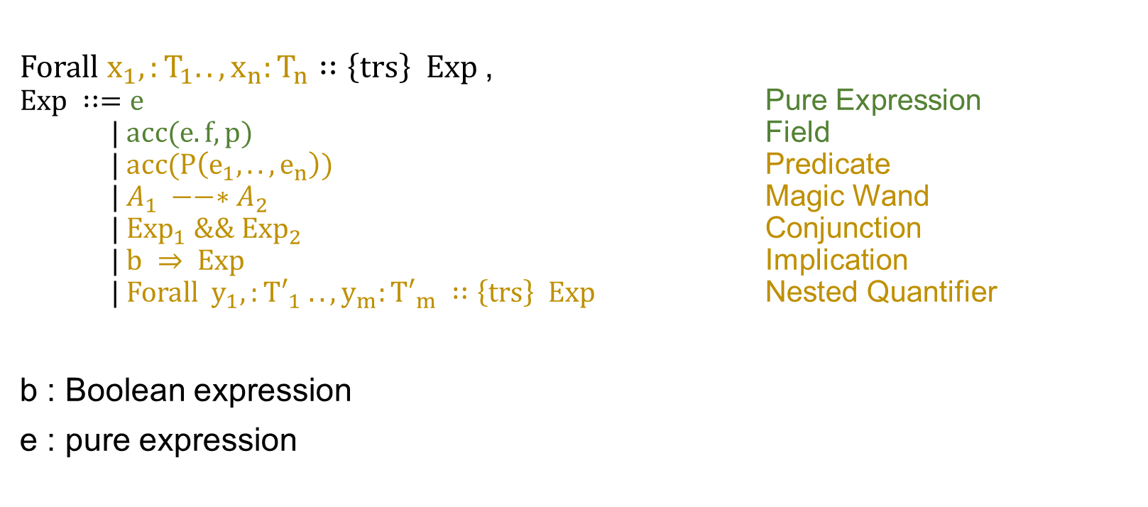
Generalisation
$Forall x_{1},:T_{1}..,x_{n}:T_{n}∷\left\{trs\right\} Exp$,
$Exp ∷=e$ Pure Expression $| acc(e.f, p)$ Field
$| acc(P\left(e_{1}, ..,e_{n}\right))$ Predicate
$| A_{1} −−∗A_{2}$ Magic Wand
$| {Exp}_{1} \&\&{ Exp}_{2}$ Conjunction
$| b ⇒ Exp$ Implication $\text{| }Forall y_{1},:{T′}_{1} ..,y_{m}:{T′}_{m} ∷\left\{trs\right\} Exp$ Nested Quantifier
b : Boolean expression
e : pure expression

Slide 7
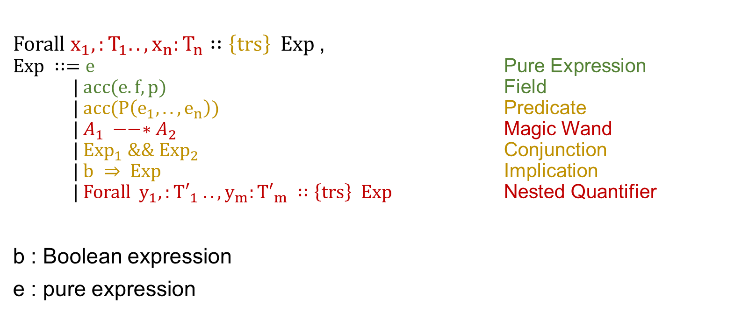
Generalisation
$Forall x_{1},:T_{1}..,x_{n}:T_{n}∷\left\{trs\right\} Exp$,
$Exp ∷=e$ Pure Expression $| acc(e.f, p)$ Field
$| acc(P\left(e_{1}, ..,e_{n}\right))$ Predicate
$| A_{1} −−∗A_{2}$ Magic Wand
$| {Exp}_{1} \&\&{ Exp}_{2}$ Conjunction
$| b ⇒ Exp$ Implication $\text{| }Forall y_{1},:{T′}_{1} ..,y_{m}:{T′}_{m} ∷\left\{trs\right\} Exp$ Nested Quantifier
b : Boolean expression
e : pure expression

Slide 8

Previously Permitted Quantifiers
$Forall x_{1},:T_{1} ..,x_{n}:T_{n}∷\left\{trs\right\} Exp$,
$Exp ∷=e$ Pure Expression $| b⇒acc(e.f, p)$ Field
$| acc(P\left(e_{1}, ..,e_{n}\right))$ Predicate
$| A_{1} −−∗A_{2}$ Magic Wand
$| {Exp}_{1} \&\&{ Exp}_{2}$ Conjunction
$| b ⇒ Exp$ Implication $\text{| }Forall y_{1},:{T′}_{1} ..,y_{m}:{T′}_{m} ∷\left\{trs\right\} Exp$ Nested Quantifier
b : Boolean expression
e : pure expression

Slide 9
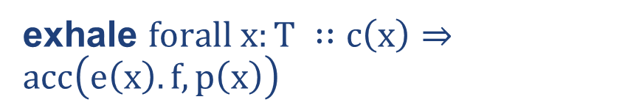
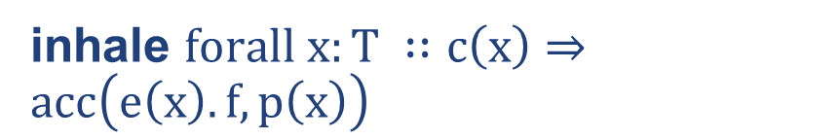
Quantified Field Permissions
inhale $forall x:T ∷c\left(x\right)⇒acc\left(e\left(x\right).f, p\left(x\right)\right)$
exhale $forall x:T ∷c\left(x\right)⇒acc\left(e\left(x\right).f, p\left(x\right)\right)$
Define inverse function
Assume receivers are non-null
Define permissions for general location
Assert injectivity
Assert sufficient permission
Define inverse function
Define permissions for general location

Slide 10
Quantified Field Permissions
Verification Condition Generation
Carbon
Symbolic Execution Generation
Silicon
Define translation of quantified inhaling and exhaling
Introduce
Heap representation
Inhaling / exhaling Quantified Field Permissions
Adapt
Inhale single field permission
Exhale single field permission
Read
Write

Slide 11
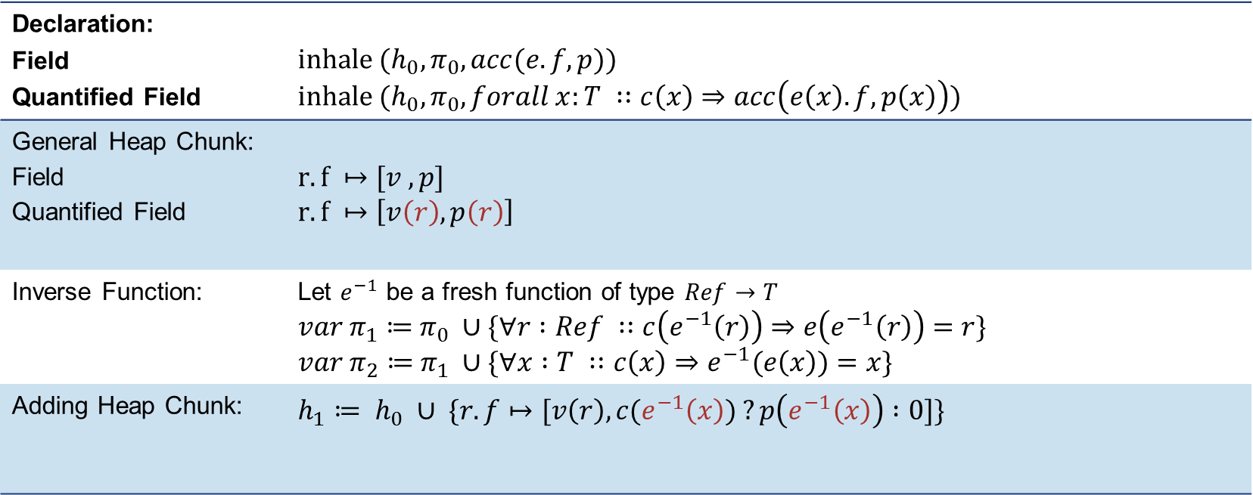
Inhaling Quantified Permissions
Declaration: Field Quantified Field | $$inhale{ (h}_{0}, π_{0}, acc(e.f, p))$$ $$inhale (h_{0}, π_{0}, forall x:T ∷c\left(x\right)⇒acc\left(e\left(x\right).f, p\left(x\right)\right))$$
General Heap Chunk: Field Quantified Field | $$r.f ↦[v ,p]$$ $$r.f ↦\left[v\left(r\right), p\left(r\right)\right]$$
Inverse Function: | Let $e^{−1}$ be a fresh function of type $Ref→T$ $var π_{1}≔$ $π_{0} ∪\{∀r :Ref ∷c\left(e^{−1}\left(r\right)\right)⇒e\left(e^{−1}\left(r\right)\right)=r\}$ $var π_{2}≔$ $π_{1} ∪\{∀x :T ∷c\left(x\right)⇒e^{−1}(e\left(x\right))=x\}$
Adding Heap Chunk: | $$h_{1}≔ h_{0} ∪ \{r.f↦[v\left(r\right), c(e^{−1}\left(x\right)) ?p\left(e^{−1}\left(x\right)\right) :0]\}$$

Slide 12
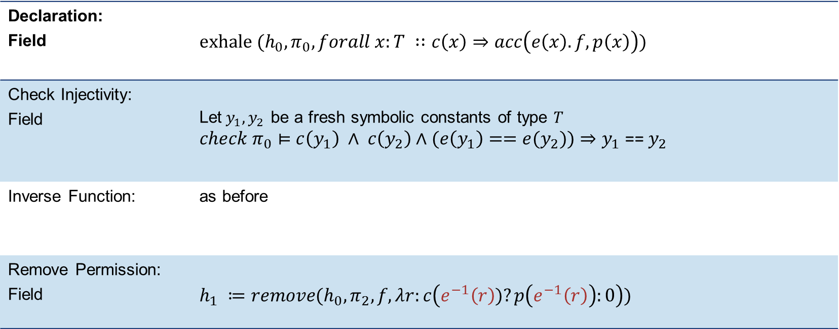
Exhaling Quantified Permissions
Declaration: Field | $$exhale (h_{0}, π_{0}, forall x:T ∷c\left(x\right)⇒acc\left(e\left(x\right).f, p\left(x\right)\right))$$
Check Injectivity: Field | Let$y_{1},y_{2}$ be a fresh symbolic constants of type $T$ $check π_{0}⊨$ $c\left(y_{1}\right) ∧ c\left(y_{2}\right)∧(e\left(y_{1}\right)=={e(y}_{2}))⇒y_{1}\text{ == }y_{2}$
Inverse Function: | as before
Remove Permission: Field | $$h_{1} ≔remove(h_{0}, π_{2}, f, λr:c\left(e^{−1}\left(r\right))?p\left(e^{−1}\left(r\right)\right):0\right))$$

Slide 13

Quantified Predicate Permissions
$Forall x_{1},:T_{1} ..,x_{n}:T_{n}∷\left\{trs\right\} Exp$,
$Exp ∷=e$ Pure Expression $| b⇒acc(e.f, p)$ Field
$| b⇒acc(P\left(e_{1}, ..,e_{n}\right))$ Predicate
$| A_{1} −−∗A_{2}$ Magic Wand
$| {Exp}_{1} \&\&{ Exp}_{2}$ Conjunction
$| b ⇒ Exp$ Implication $\text{| }Forall y_{1},:{T′}_{1} ..,y_{m}:{T′}_{m} ∷\left\{trs\right\} Exp$ Nested Quantifier
b : Boolean expression
e : pure expression

Slide 14
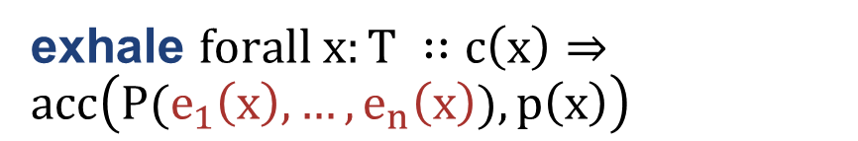
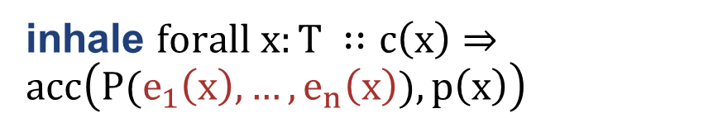
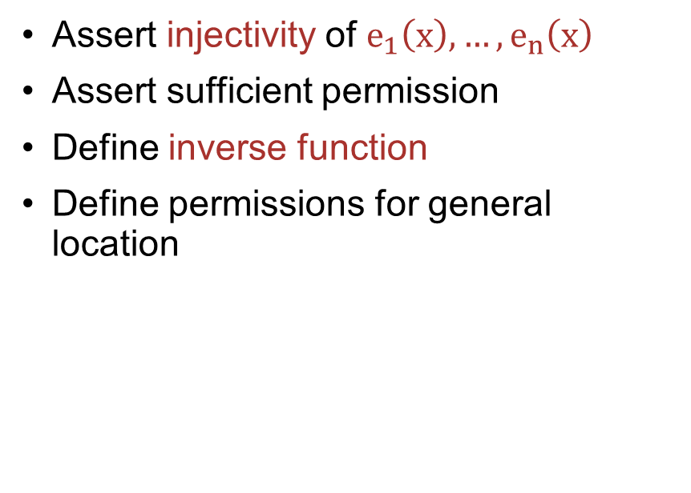
Quantified Predicate Permissions
inhale $forall x:T ∷c\left(x\right)⇒acc\left(P(e_{1}\left(x\right), …,e_{n}\left(x\right)), p\left(x\right)\right)$
exhale $forall x:T ∷c\left(x\right)⇒acc\left(P(e_{1}\left(x\right), …,e_{n}\left(x\right)), p\left(x\right)\right)$
Define inverse function
Define permissions for general location
Assert injectivity of $e_{1}\left(x\right), …,e_{n}\left(x\right)$
Assert sufficient permission
Define inverse function
Define permissions for general location

Slide 15
Quantified Predicate Permissions
Verification Condition Generation
Carbon
Symbolic Execution Generation
Silicon
Define translation of quantified inhaling and exhaling
Introduce
Heap representation
Quantified inhaling of predicates
Quantified exhaling of predicates
Adapt
Inhale single predicate permission
Exhale single predicate permission
Fold
Unfold

Slide 16
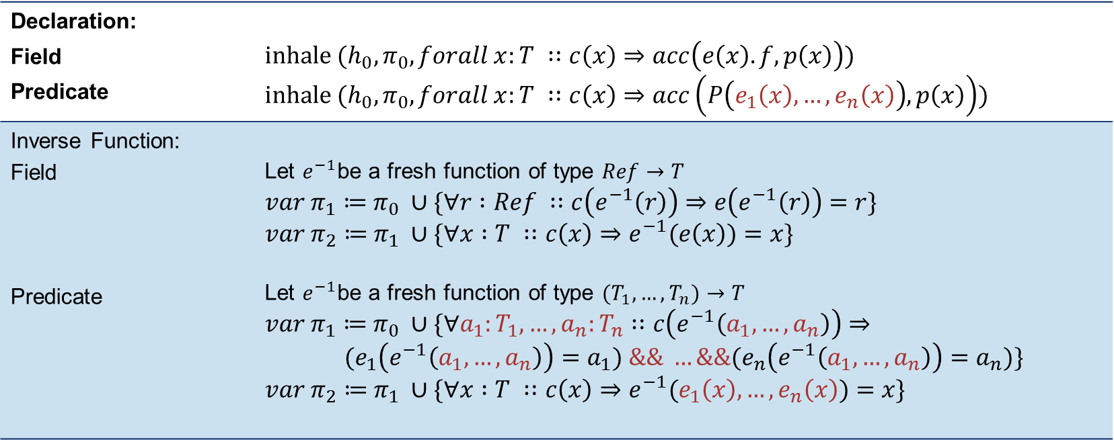
Inhaling Quantified Permissions
Declaration: Field Predicate | $$inhale (h_{0}, π_{0}, forall x:T ∷c\left(x\right)⇒acc\left(e\left(x\right).f, p\left(x\right)\right))$$ $$inhale (h_{0}, π_{0}, forall x:T ∷c\left(x\right)⇒acc\left(P\left(e_{1}\left(x\right), …,e_{n}\left(x\right)\right), p\left(x\right)\right))$$
Inverse Function: Field Predicate | Let $e^{−1}$be a fresh function of type $Ref→T$ $var π_{1}≔$ $π_{0} ∪\{∀r :Ref ∷c\left(e^{−1}\left(r\right)\right)⇒e\left(e^{−1}\left(r\right)\right)=r\}$ $var π_{2}≔$ $π_{1} ∪\{∀x :T ∷c\left(x\right)⇒e^{−1}(e\left(x\right))=x\}$ Let $e^{−1}$be a fresh function of type $(T_{1}, …,T_{n})→T$ $var π_{1}≔$ $π_{0} ∪\{∀a_{1}:T_{1}, …,a_{n}:T_{n}∷c\left(e^{−1}\left(a_{1}, …,a_{n}\right)\right)⇒$ $${(e}_{1}\left(e^{−1}\left(a_{1}, …,a_{n}\right)\right)=a_{1}) \&\& …\&\&{(e}_{n}\left(e^{−1}\left(a_{1}, …,a_{n}\right)\right)=a_{n})\}$$ $var π_{2}≔$ $π_{1} ∪\{∀x :T ∷c\left(x\right)⇒e^{−1}(e_{1}\left(x\right), …,e_{n}\left(x\right))=x\}$

Slide 17
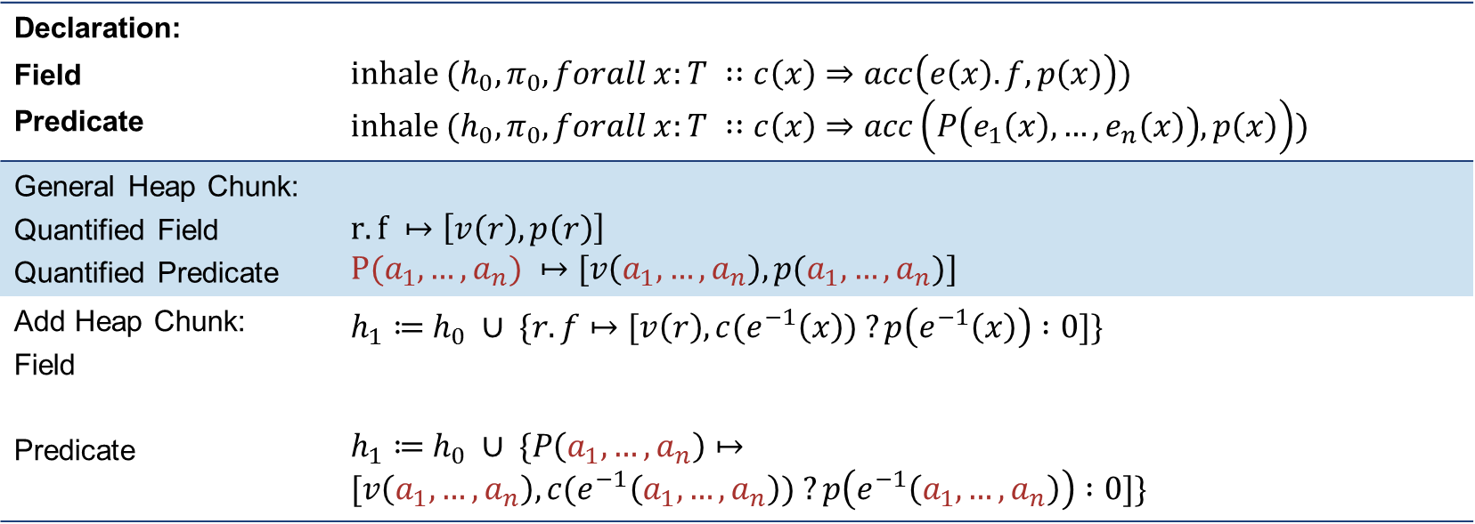
Inhaling Quantified Permissions
Declaration: Field Predicate | $$inhale (h_{0}, π_{0}, forall x:T ∷c\left(x\right)⇒acc\left(e\left(x\right).f, p\left(x\right)\right))$$ $$inhale (h_{0}, π_{0}, forall x:T ∷c\left(x\right)⇒acc\left(P\left(e_{1}\left(x\right), …,e_{n}\left(x\right)\right), p\left(x\right)\right))$$
General Heap Chunk: Quantified Field Quantified Predicate | $$r.f ↦\left[v\left(r\right), p\left(r\right)\right]$$ $$P(a_{1}, …, a_{n}) ↦[v\left(a_{1}, …, a_{n}\right), p(a_{1}, …, a_{n})]$$
Add Heap Chunk: Field Predicate | $h_{1}≔$ $h_{0} ∪ \{r.f↦[v\left(r\right), c(e^{−1}\left(x\right)) ?p\left(e^{−1}\left(x\right)\right) :0]\}$ $h_{1}≔$ $h_{0} ∪ \{P\left(a_{1}, …,a_{n}\right)↦[v\left(a_{1}, …,a_{n}\right), c(e^{−1}\left(a_{1}, …,a_{n}\right)) ?p\left(e^{−1}\left(a_{1}, …,a_{n}\right)\right) :0]\}$

Slide 18
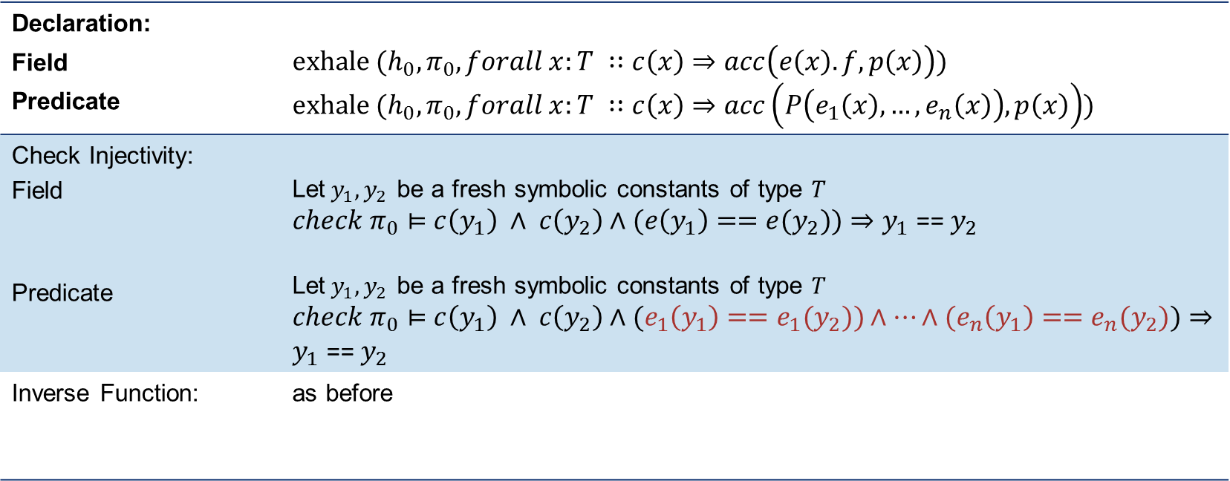
Exhaling Quantified Permissions
Declaration: Field Predicate | $$exhale (h_{0}, π_{0}, forall x:T ∷c\left(x\right)⇒acc\left(e\left(x\right).f, p\left(x\right)\right))$$ $$exhale (h_{0}, π_{0}, forall x:T ∷c\left(x\right)⇒acc\left(P\left(e_{1}\left(x\right), …,e_{n}\left(x\right)\right), p\left(x\right)\right))$$
Check Injectivity: Field Predicate | Let$y_{1},y_{2}$ be a fresh symbolic constants of type $T$ $check π_{0}⊨$ $c\left(y_{1}\right) ∧ c\left(y_{2}\right)∧(e\left(y_{1}\right)=={e(y}_{2}))⇒y_{1}\text{ == }y_{2}$ Let$y_{1},y_{2}$ be a fresh symbolic constants of type $T$ $check π_{0}⊨$ $c\left(y_{1}\right) ∧ c\left(y_{2}\right)∧(e_{1}\left(y_{1}\right)=={e_{1}(y}_{2}))∧…∧(e_{n}\left(y_{1}\right)=={e_{n}(y}_{2}))⇒y_{1}\text{ == }y_{2}$
Inverse Function: | as before

Slide 19
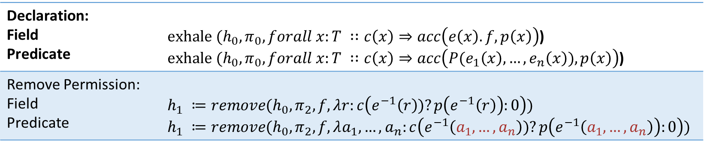
Exhaling Quantified Permissions
Declaration: Field Predicate | $exhale (h_{0}, π_{0}, forall x:T ∷c\left(x\right)⇒acc\left(e\left(x\right).f, p\left(x\right)\right)$) $exhale (h_{0}, π_{0}, forall x:T ∷c\left(x\right)⇒acc\left(P(e_{1}\left(x\right), …,e_{n}\left(x\right)), p\left(x\right)\right)$)
Remove Permission: Field Predicate | $$h_{1} ≔remove(h_{0}, π_{2}, f, λr:c\left(e^{−1}\left(r\right))?p\left(e^{−1}\left(r\right)\right):0\right))$$ $$h_{1} ≔remove(h_{0}, π_{2}, f, λa_{1}, …,a_{n}:c\left(e^{−1}\left(a_{1}, …,a_{n}\right))?p\left(e^{−1}\left(a_{1}, …,a_{n}\right)\right):0\right))$$

Slide 20
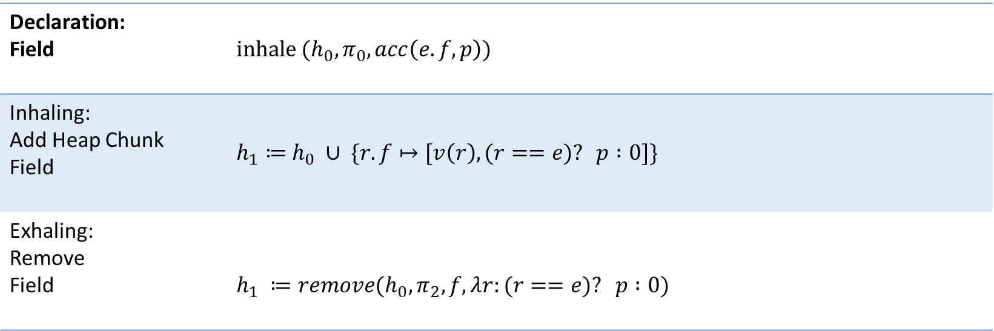
Inhaling/Exhaling Unquantified Permissions
Declaration: Field | $$inhale (h_{0}, π_{0}, acc\left(e.f, p\right))$$
Inhaling: Add Heap Chunk Field | $h_{1}≔$ $h_{0} ∪ \{r.f↦[v\left(r\right), (r==e)? p :0]\}$
Exhaling: Remove Field | $$h_{1} ≔remove(h_{0}, π_{2}, f, λr:(r==e)? p :0)$$

Slide 21
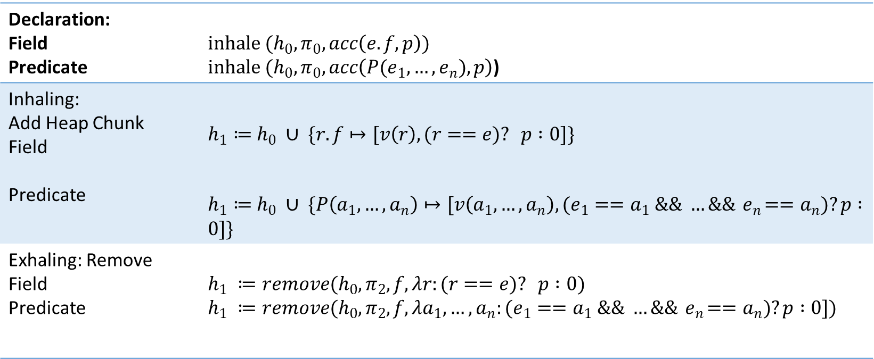
Inhaling/Exhaling Unquantified Permissions
Declaration: Field Predicate | $$inhale (h_{0}, π_{0}, acc\left(e.f, p\right))$$ $inhale (h_{0}, π_{0}, acc\left(P(e_{1}, …,e_{n}), p\right)$)
Inhaling: Add Heap Chunk Field Predicate | $h_{1}≔$ $h_{0} ∪ \{r.f↦[v\left(r\right), (r==e)? p :0]\}$ $h_{1}≔$ $h_{0} ∪ \{P\left(a_{1}, …,a_{n}\right)↦[v\left(a_{1}, …,a_{n}\right), (e_{1}==a_{1} \&\& …\&\&{ e}_{n}==a_{n})?p :0]\}$
Exhaling: Remove Field Predicate | $$h_{1} ≔remove(h_{0}, π_{2}, f, λr:(r==e)? p :0)$$ $$h_{1} ≔remove(h_{0}, π_{2}, f, λa_{1}, …,a_{n}:(e_{1}==a_{1} \&\& …\&\&{ e}_{n}==a_{n})?p :0])$$

Slide 22
Demo

Slide 23

Quantified Predicate Permissions
$Forall x_{1},:T_{1} ..,x_{n}:T_{n}∷\left\{trs\right\} Exp$,
$Exp ∷=e$ Pure Expression $| b⇒acc(e.f, p)$ Field
$| b⇒acc(P\left(e_{1}, ..,e_{n}\right))$ Predicate
$| b⇒A_{1} −−∗A_{2}$ Magic Wand
$| {Exp}_{1} \&\&{ Exp}_{2}$ Conjunction
$| b ⇒ Exp$ Implication $\text{| }Forall y_{1},:{T′}_{1} ..,y_{m}:{T′}_{m} ∷\left\{trs\right\} Exp$ Nested Quantifier
b : Boolean expression
e : pure expression

Slide 24
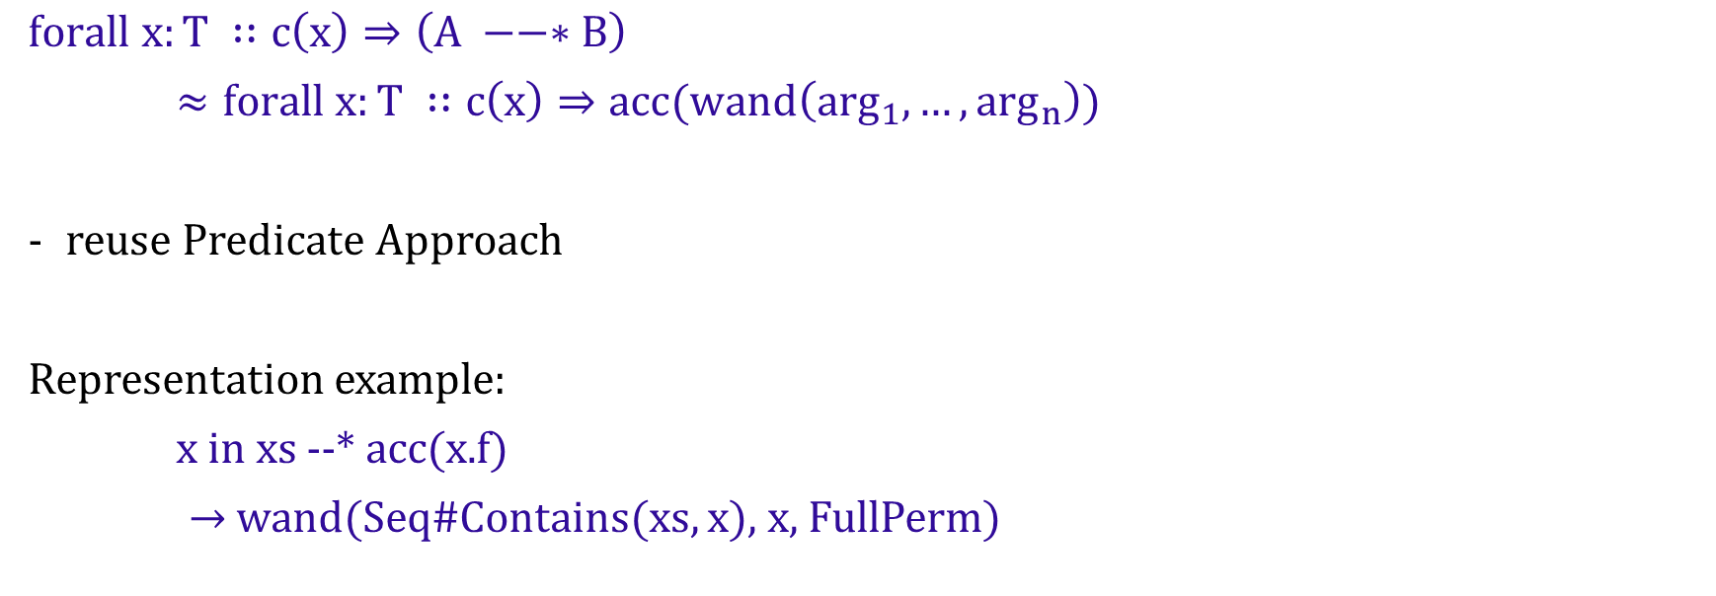
Quantified Magic Wand Permissions
might depend on x
$$forall x:T ∷c\left(x\right)⇒\left(A −−∗B\right)$$
$≈forall x:T ∷c\left(x\right)⇒acc(wand\left(\arg_{1}, …,\arg_{n}\right))$
reuse Predicate Approach
Representation example:
x in xs --* acc(x.f)
$→$wand(Seq#Contains(xs, x), x, FullPerm)

Slide 25

Combinations of Quantifiers
$Forall x_{1},:T_{1} ..,x_{n}:T_{n}∷\left\{trs\right\} Exp$,
$Exp ∷=e$ Pure Expression $| acc(e.f, p)$ Field
$| acc(P\left(e_{1}, ..,e_{n}\right))$ Predicate
$| A_{1} −−∗A_{2}$ Magic Wand
$| {Exp}_{1} \&\&{ Exp}_{2}$ Conjunction
$| b ⇒ Exp$ Implication $\text{| }Forall y_{1},:{T′}_{1} ..,y_{m}:{T′}_{m} ∷\left\{trs\right\} Exp$ Nested Quantifier
b : Boolean expression
e : pure expression

Slide 26

Combination: Rewriting Rules
No condition defined:
$rewrite(forall x:T∷\left\{trs\right\} e$) $forall x∷\left\{trs\right\} true⇒e$

Slide 27
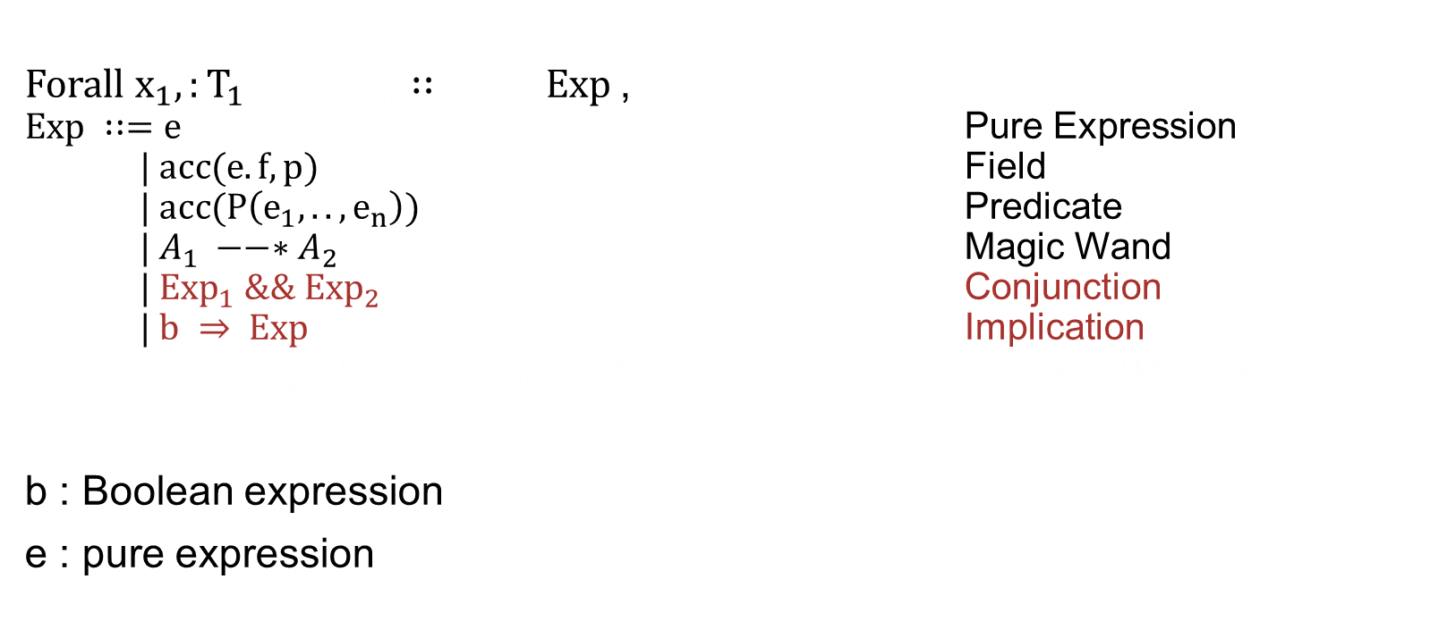
Combinations of Quantifiers
$Forall x_{1},:T_{1} ..,x_{n}:T_{n}∷\left\{trs\right\} Exp$,
$Exp ∷=e$ Pure Expression $| acc(e.f, p)$ Field
$| acc(P\left(e_{1}, ..,e_{n}\right))$ Predicate
$| A_{1} −−∗A_{2}$ Magic Wand
$| {Exp}_{1} \&\&{ Exp}_{2}$ Conjunction
$| b ⇒ Exp$ Implication $\text{| }Forall y_{1},:{T′}_{1} ..,y_{m}:{T′}_{m} ∷\left\{trs\right\} Exp$ Nested Quantifier
b : Boolean expression
e : pure expression

Slide 28

Combination: Rewriting Rules
rewrite ($forall x:T∷\left\{trs\right\} c⇒e$) :
$case e.isPure$:
e
case $e_{1} \&\&{ e}_{2}:$
rewrite($forall x:T∷\left\{trs\right\} c⇒e_{1}) \&\& rewrite(forall x:T∷\left\{trs\right\} c⇒e_{2})$
case${ c}_{2} ⇒ e$:
rewrite($forall x:T∷\left\{trs\right\}{ (c \&\& c}_{2})⇒e)$
others:
e

Slide 29
Demo

Slide 30
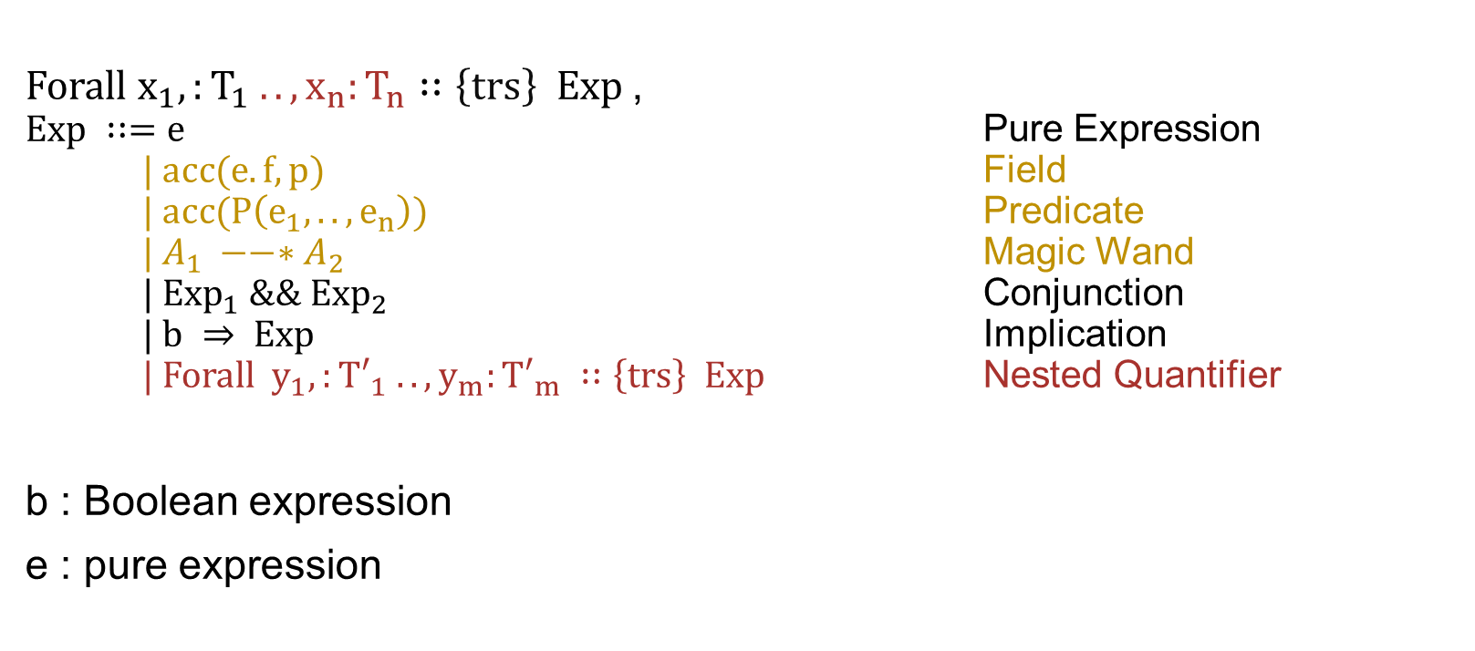
Nested Quantifiers
$Forall x_{1},:T_{1} ..,x_{n}:T_{n}∷\left\{trs\right\} Exp$,
$Exp ∷=e$ Pure Expression $| acc(e.f, p)$ Field
$| acc(P\left(e_{1}, ..,e_{n}\right))$ Predicate
$| A_{1} −−∗A_{2}$ Magic Wand
$| {Exp}_{1} \&\&{ Exp}_{2}$ Conjunction
$| b ⇒ Exp$ Implication $\text{| }Forall y_{1},:{T′}_{1} ..,y_{m}:{T′}_{m} ∷\left\{trs\right\} Exp$ Nested Quantifier
b : Boolean expression
e : pure expression

Slide 31

Adapted Rewriting Rules
rewrite ($x_{1}:T_{1},…,x_{n}:T_{n}∷\left\{trs\right\} c⇒e$)
$case e.isPure$:
e
case $e_{1} \&\&{ e}_{2}:$
rewrite($forall x:T∷\left\{trs\right\} c⇒e_{1}) \&\& forall x:T∷\left\{trs\right\} c⇒e_{2})$
case${ c}_{2} ⇒ e$:
rewrite($forall x:T∷\left\{trs\right\}{ (c \&\& c}_{2})⇒e)$
case $forall y_{1}:{T′}_{1},…,y_{n}:{T′}_{n}∷\left\{{trs}_{2}\right\}{ c}_{2}⇒e$ :
rewrite($forall{ x}_{1}:T_{1},…,x_{n}:T_{n}, y_{1}:{T^{′}}_{1},…,y_{n}:{T^{′}}_{n}∷ \left\{trs{ × trs}_{2}\right\} (c \&\&{ c}_{2})⇒e)$
others:
e

Slide 32
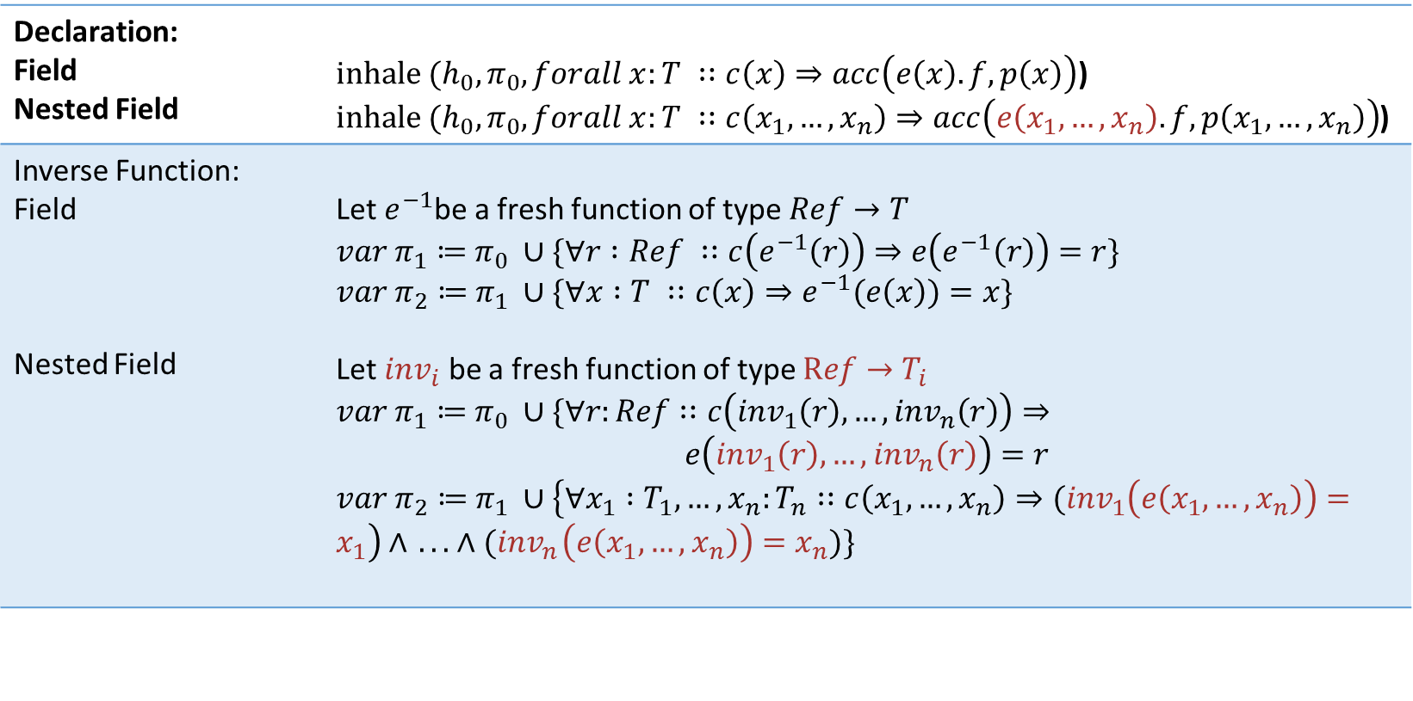
Inhaling Nested Quantified Field Permissions
Declaration: Field Nested Field | $inhale (h_{0}, π_{0}, forall x:T ∷c\left(x\right)⇒acc\left(e\left(x\right).f, p\left(x\right)\right)$) $inhale (h_{0}, π_{0}, forall x:T ∷c\left(x_{1}, …,x_{n}\right)⇒acc\left(e\left(x_{1}, …,x_{n}\right).f, p\left(x_{1}, …,x_{n}\right)\right)$)
Inverse Function: Field Nested Field | Let $e^{−1}$be a fresh function of type $Ref→T$ $var π_{1}≔$ $π_{0} ∪\{∀r :Ref ∷c\left(e^{−1}\left(r\right)\right)⇒e\left(e^{−1}\left(r\right)\right)=r\}$ $var π_{2}≔$ $π_{1} ∪\{∀x :T ∷c\left(x\right)⇒e^{−1}(e\left(x\right))=x\}$ Let ${inv}_{i}$ be a fresh function of type $Ref→T_{i}$ $var π_{1}≔$ $π_{0} ∪\{∀r:Ref∷c\left({inv}_{1}\left(r\right), …,{inv}_{n}\left(r\right)\right)⇒$ $$e\left({inv}_{1}\left(r\right), …,{inv}_{n}\left(r\right)\right)=r$$ $var π_{2}≔$ $π_{1} ∪\left\{∀x_{1} :T_{1}, …,x_{n}:T_{n}∷c\left(x_{1}, …,x_{n}\right)⇒{(inv}_{1}\left(e\left(x_{1}, …,x_{n}\right)\right)=x_{1}\right)∧{ .. . ∧(inv}_{n}\left(e\left(x_{1}, …,x_{n}\right)\right)=x_{n})\}$

Slide 33
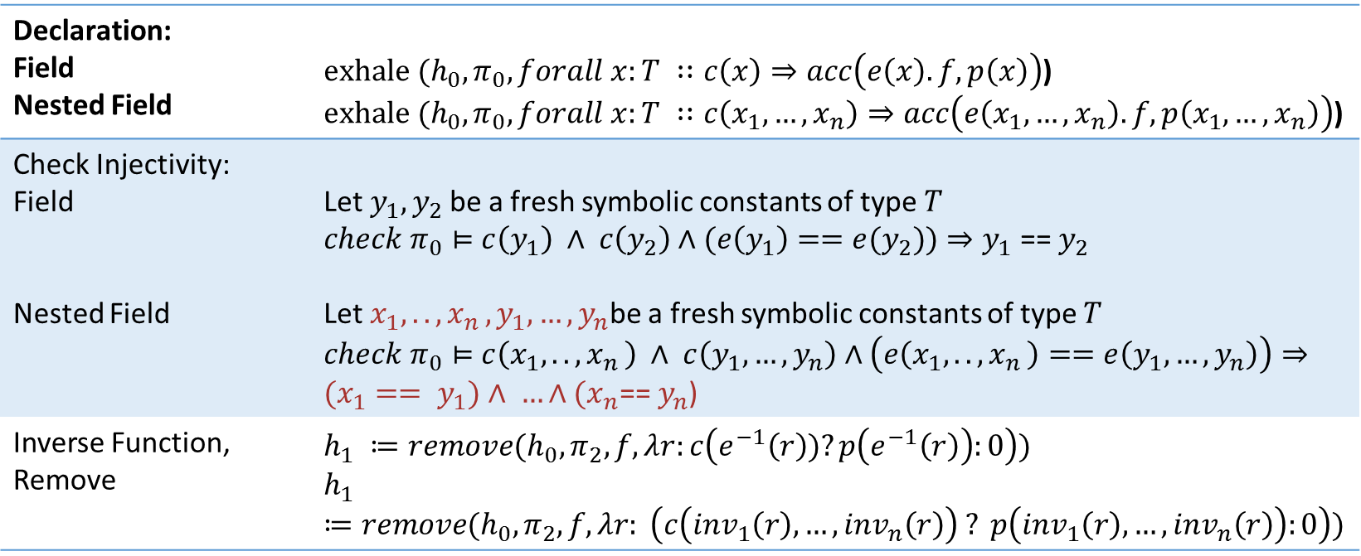
Exhaling Nested Quantified Field Permissions
Declaration: Field Nested Field | $exhale (h_{0}, π_{0}, forall x:T ∷c\left(x\right)⇒acc\left(e\left(x\right).f, p\left(x\right)\right)$) $exhale (h_{0}, π_{0}, forall x:T ∷c\left(x_{1}, …,x_{n}\right)⇒acc\left(e\left(x_{1}, …,x_{n}\right).f, p\left(x_{1}, …,x_{n}\right)\right)$)
Check Injectivity: Field Nested Field | Let$y_{1},y_{2}$ be a fresh symbolic constants of type $T$ $check π_{0}⊨$ $c\left(y_{1}\right) ∧ c\left(y_{2}\right)∧(e\left(y_{1}\right)=={e(y}_{2}))⇒y_{1}\text{ == }y_{2}$ Let$x_{1},..,x_{n },y_{1}, …,y_{n}$be a fresh symbolic constants of type $T$ $check π_{0}⊨$ $c\left(x_{1},..,x_{n }\right) ∧ c\left(y_{1}, …,y_{n}\right)∧\left(e\left(x_{1},..,x_{n }\right)==e\left(y_{1}, …,y_{n}\right)\right)⇒(x_{1}== y_{1})∧ …∧{(x}_{n}\text{==}{ y}_{n}$)
Inverse Function, Remove | $$h_{1} ≔remove(h_{0}, π_{2}, f, λr:c\left(e^{−1}\left(r\right))?p\left(e^{−1}\left(r\right)\right):0\right))$$ $$h_{1} ≔remove(h_{0}, π_{2}, f, λr: \left(c\left({inv}_{1}\left(r\right), …,{inv}_{n}\left(r\right)\right) ? p\left({inv}_{1}\left(r\right), …,{inv}_{n}\left(r\right)\right):0\right))$$

Slide 34
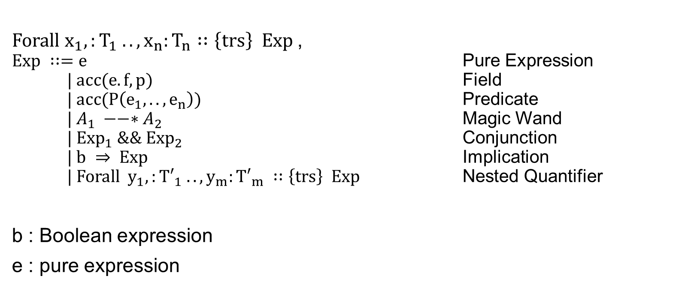
Generalisation
$Forall x_{1},:T_{1} ..,x_{n}:T_{n}∷\left\{trs\right\} Exp$,
$Exp ∷=e$ Pure Expression $| acc(e.f, p)$ Field
$| acc(P\left(e_{1}, ..,e_{n}\right))$ Predicate
$| A_{1} −−∗A_{2}$ Magic Wand
$| {Exp}_{1} \&\&{ Exp}_{2}$ Conjunction
$| b ⇒ Exp$ Implication $\text{| }Forall y_{1},:{T′}_{1} ..,y_{m}:{T′}_{m} ∷\left\{trs\right\} Exp$ Nested Quantifier
b : Boolean expression
e : pure expression

